Slide 1
Iakobos

Slide 2
James the son of Zebedee
(James the great)
James the son of Alphaeus
(James the lesser)

Slide 3
Santiago de Compostella
(Iago matches Iako, the beginning of Iakobos)

Slide 4
James, a servant of God and of the Lord Jesus Christ

Slide 5
Isn’t this the carpenter’s son? Isn’t his mother’s name Mary, and aren’t his brothers James, Joseph, Simon and Judas? Aren’t all his sisters with us? Where then did this man get all these things?” And they took offence at him. (Mt.13:54-57)

Slide 6
Then Jesus entered a house, and again a crowd gathered, so that he and his disciples were not even able to eat. When his family heard about this, they went to take charge of him, for they said, “He is out of his mind.” (Mk.2:20,21)

Slide 7
Jesus appeared to Peter, and then to the Twelve. After that, he appeared to more than five hundred of the brothers and sisters at the same time, most of whom are still living, though some have fallen asleep. Then he appeared to James, then to all the apostles, and last of all he appeared to me also, as to one abnormally born.
(1 Cor.15:5-8)

Slide 8
The whole assembly became silent as they listened to Barnabas and Paul telling about the signs and wonders God had done among the Gentiles through them. When they finished, James spoke up. “Brothers,” he said, “listen to me. Simon has described to us how God first intervened to choose a people for his name from the Gentiles. The words of the prophets are in agreement with this...It is my judgment, therefore, that we should not make it difficult for the Gentiles who are turning to God. Instead we should write to them, telling them to abstain from food polluted by idols, from sexual immorality, from the meat of strangled animals and from blood. For the law of Moses has been preached in every city from the earliest times and is read in the synagogues on every Sabbath.” (Acts 15:12-21)

Slide 9
Diaspora

Slide 10
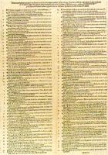
The 95 Theses
1. When our Lord and Master Jesus Christ said, ``Repent'' (Mt 4:17), he willed the entire life of believers to be one of repentance.
2. This word cannot be understood as referring to the sacrament of penance, that is, confession and satisfaction, as administered by the clergy.
3. Yet it does not mean solely inner repentance; such inner repentance is worthless unless it produces various outward mortification of the flesh.
4. The penalty of sin remains as long as the hatred of self (that is, true inner repentance), namely till our entrance into the kingdom of heaven.
5. The pope neither desires nor is able to remit any penalties except those imposed by his own authority or that of the canons.

Slide 11
If the epistle is
‘of straw’, then there is within that straw a very hearty, firm and nourishing grain!

Slide 12
Better or bitter!

Slide 13
Blessed are you when people insult you, persecute you and falsely say all kinds of evil against you because of me. Rejoice and be glad, because great is your reward in heaven, for in the same way they persecuted the prophets who were before you (Mt.5:10-12)

Slide 14
God had reasons behind my suffering, and learning some of them has made all the difference in the world!

Slide 15
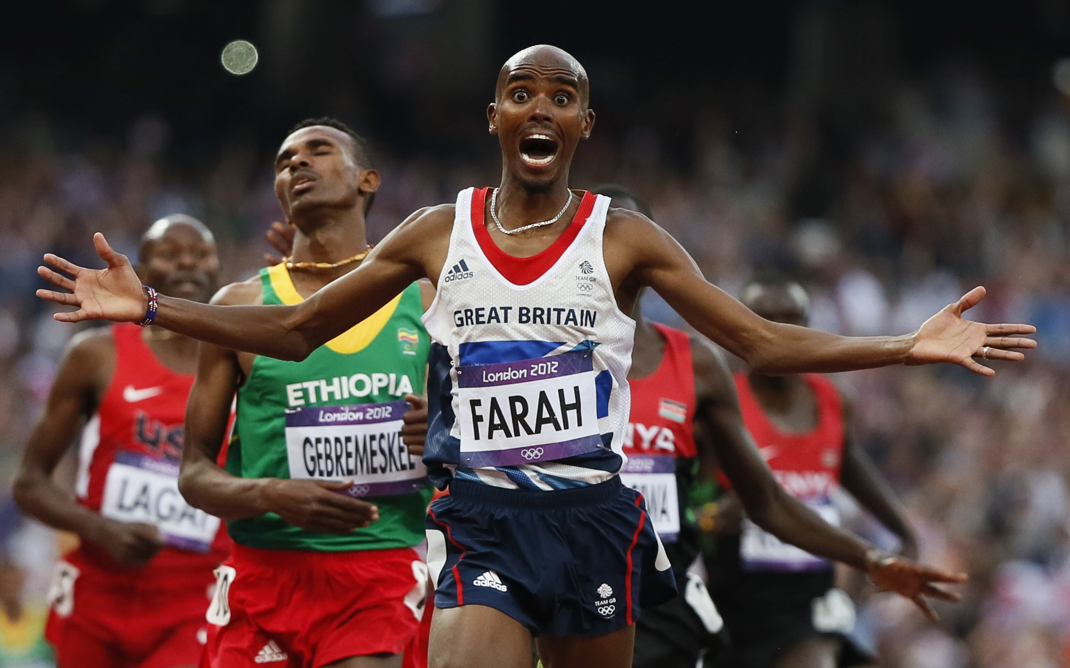

Slide 16
If any of you lacks wisdom, you should ask God, who gives generously to all without finding fault, and it will be given to you.

Slide 17
Believers in humble circumstances ought to take pride in their high position. But the rich should take pride in their low position, since they will pass away like a wild flower. For the sun rises with scorching heat and withers the plant; its blossom falls and its beauty is destroyed. In the same way, the rich will fade away even while they go about their business.
(vv.9-11)

Slide 18
Do not store up for yourselves treasures on earth, where moth and rust destroy, and where thieves break in and steal. But store up for yourselves treasures in heaven, where moth and rust do not destroy, and where thieves do not break in and steal. For where your treasure is, there your heart will be also.’
(Mt.6:19-21)

Slide 19
Blessed are you who are poor, for yours is the kingdom of God
(Lk.6:20)

