Slide 1
Where can I go from your Spirit? Where can I flee from your presence?

Slide 2
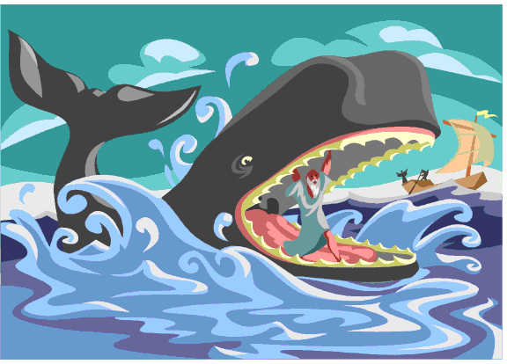

Slide 3
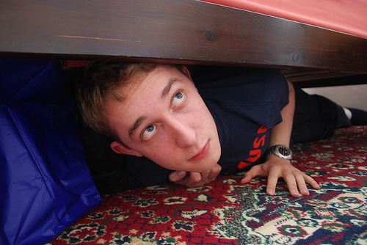

Slide 4
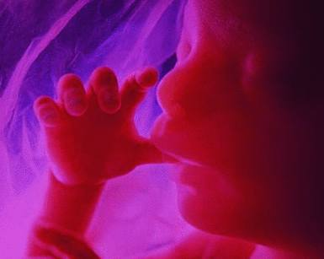

Slide 5
All the days ordained for me were written in your book before one of them came to be

Slide 6
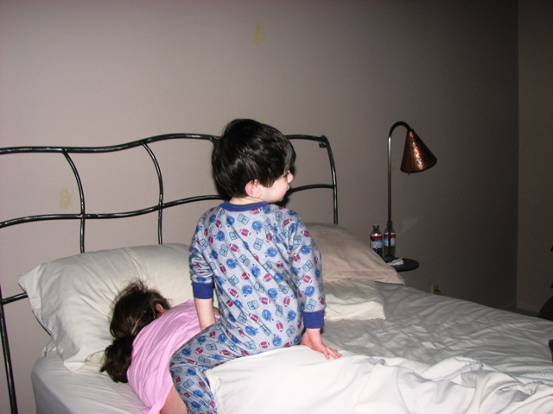

Slide 7
Search me, O God, and know my heart; test me and know my anxious thoughts. See if there is any offensive way in me, and lead me in the way everlasting

Slide 8
If we confess our sins, he is faithful and just and will forgive us our sins and purify us from all unrighteousness

